Slide 1
The Fully Framed Cross-section
Based on HM Sloop Echo, 1781
Model by Greg Herbert
Plans by David Antscherl

Slide 2
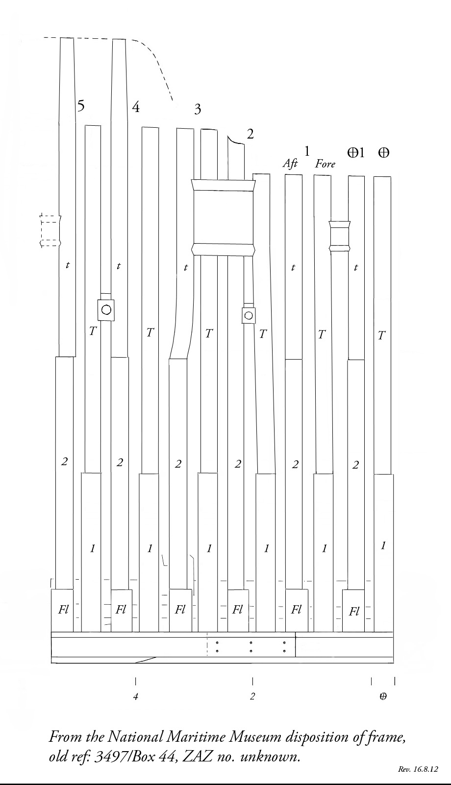

Slide 3
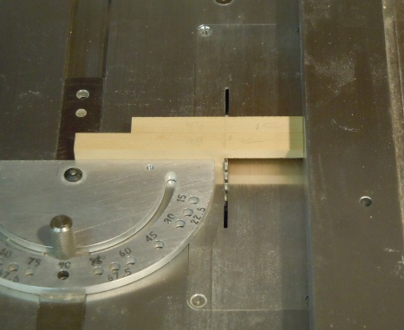
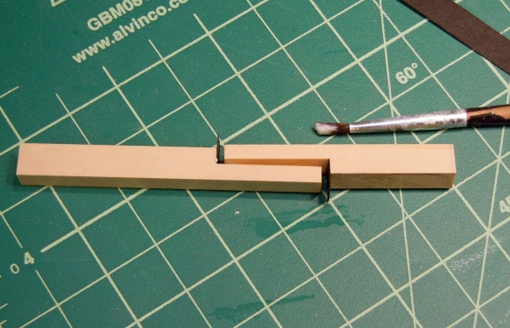
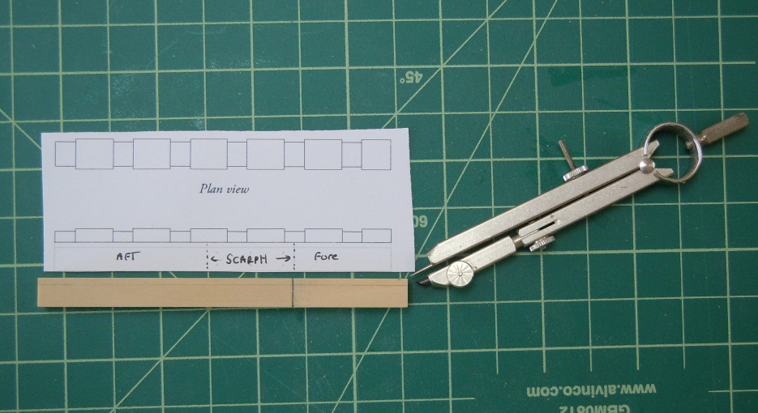
The Keel
Scarph position
Cutting scarph joint
on Byrnes saw
Gluing with black paper
Marking rabbet

Slide 4
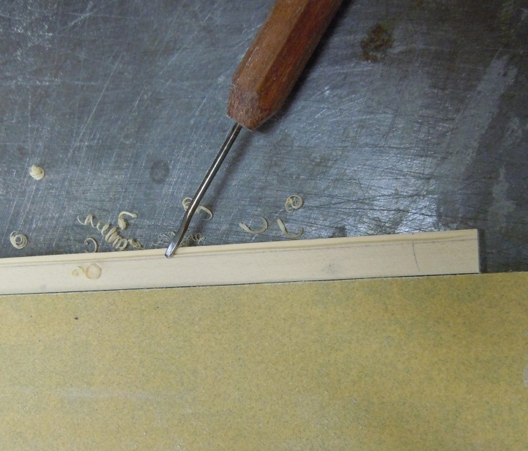
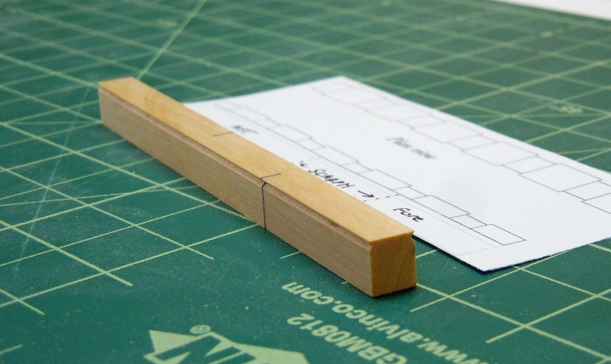
Cutting the Rabbet
Using the mill with 45 degree bit
Using a micro gouge, V-shaped

Slide 5
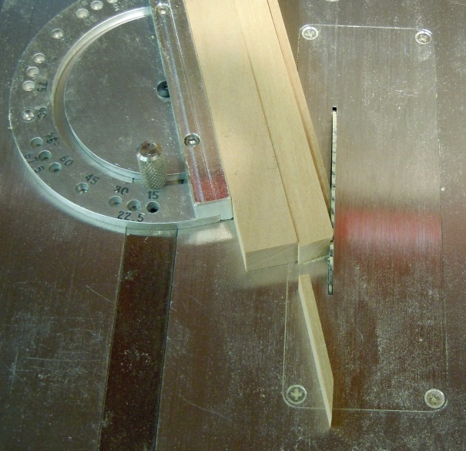
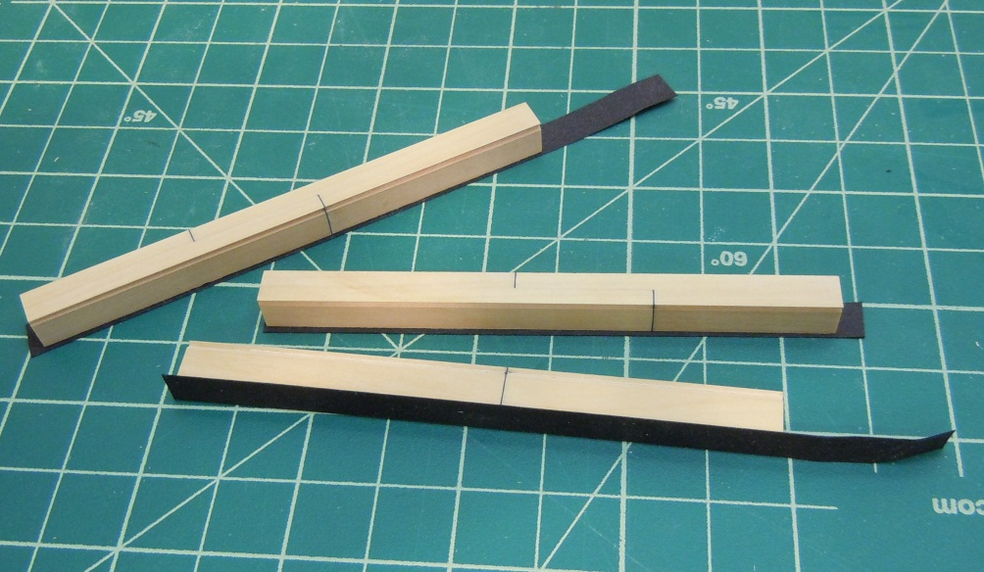
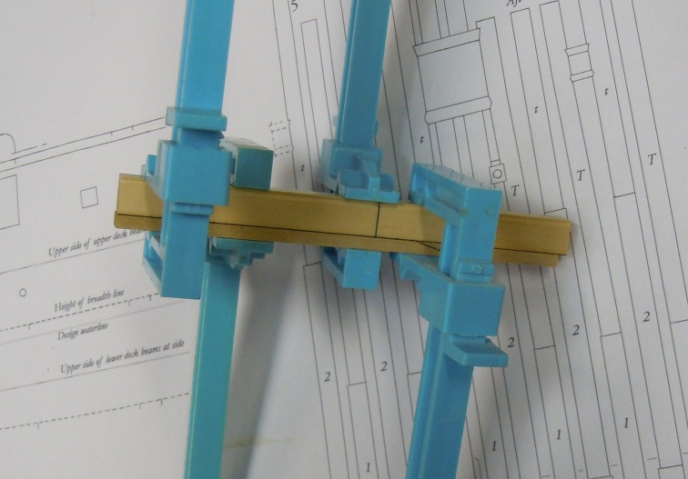
False Keel
Harris cut joints
“Tarred” paper glued to bottom of keel
The false keel is
glued to the keel

Slide 6
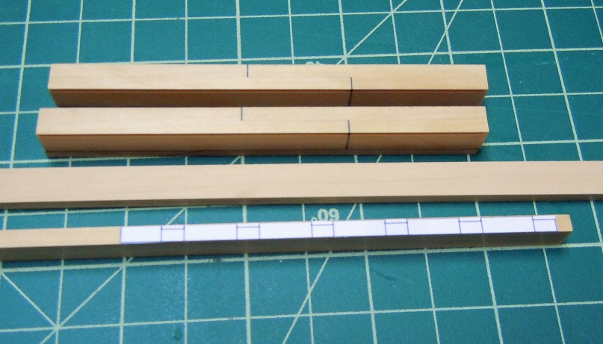
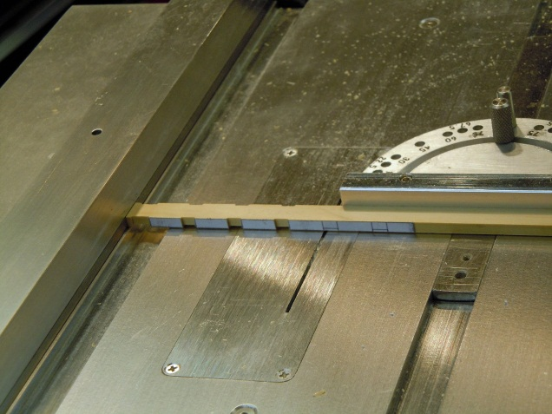
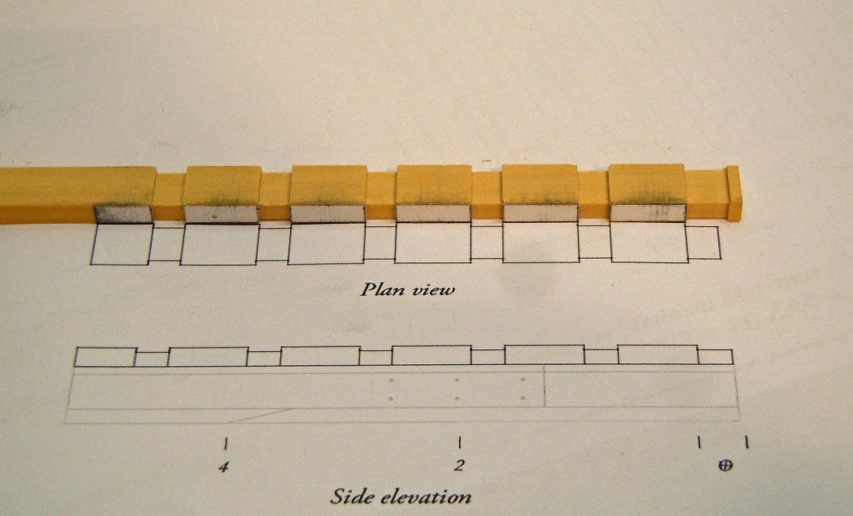
Rising Wood
The rising wood pattern is rubber cemented to the wood blank. The scores are cut on the table saw using the fence as a stop for accuracy on all three sides.

Slide 7
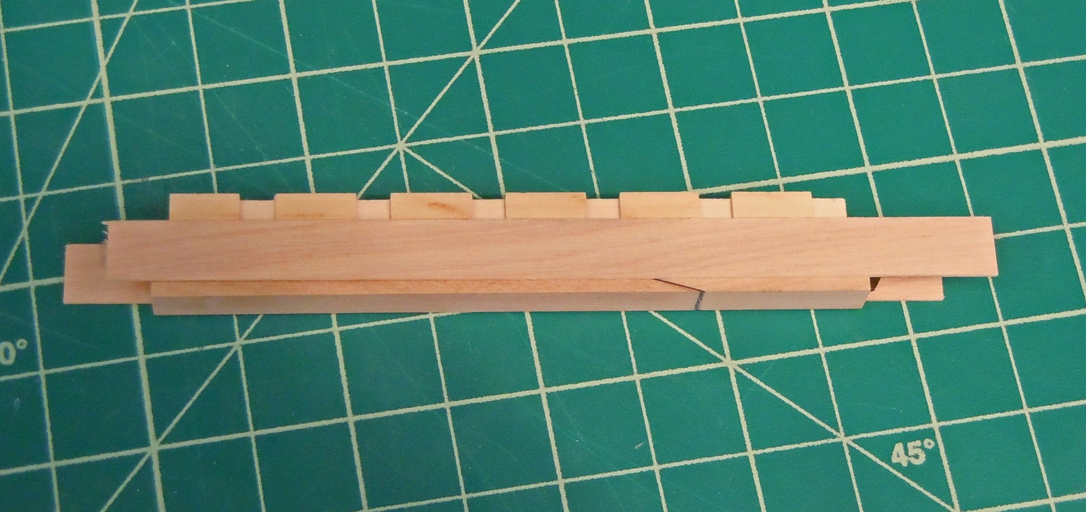
Rising Wood/Keel Assembly
Using 1 ½” spacers, the rising wood is glued to the keel. It should overhang the keel by 1 ½” on each side.

Slide 8
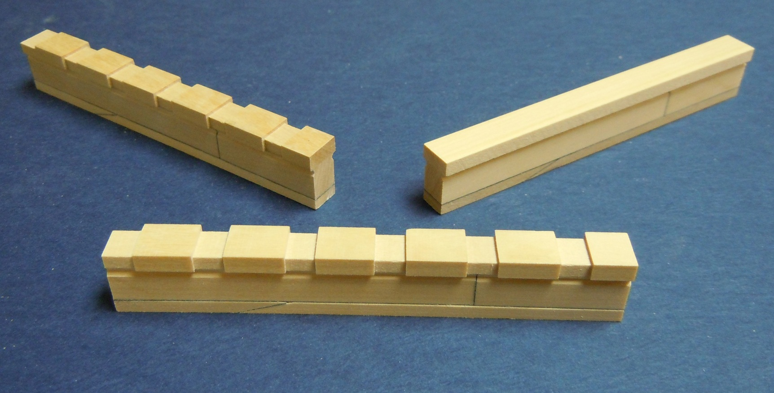
Completed Keel, False Keel, and Rising Wood
The completed scored rising wood assemblies and non-scored (upper right) assembly.

Slide 9
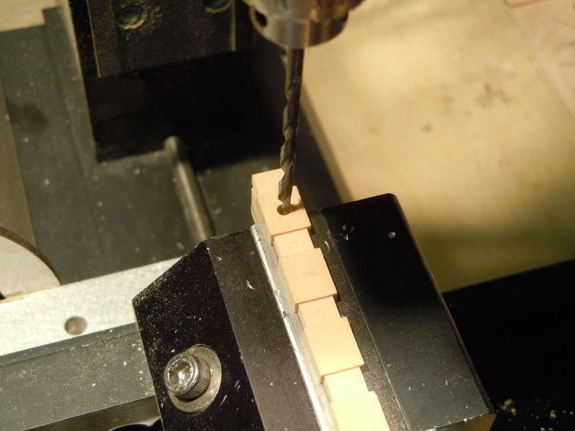
Bolting Keel to Building Board
Holes are drilled in the proper locations on the keel and a 6-32 tap creates the threaded hole.

Slide 10
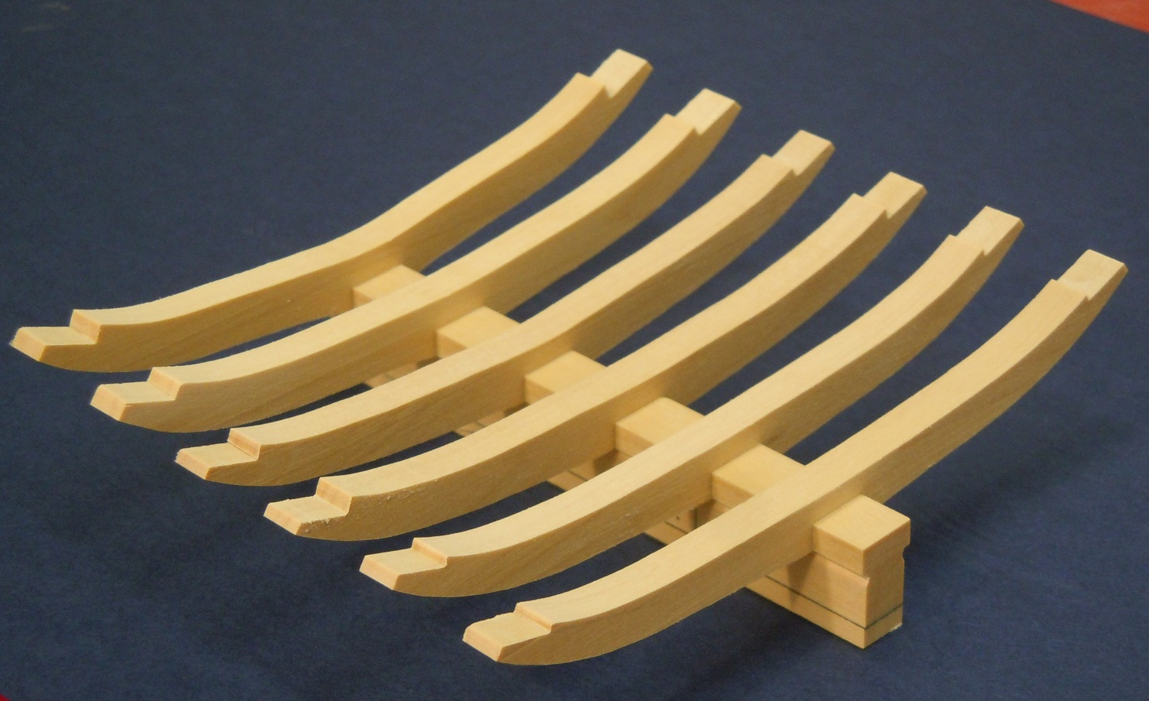
Raising the Floors
Raising the floors is relatively simple. The mortise is cut first to fit snugly onto the keel. The patterns are applied with rubber cement. The floors are then cut to shape using a scrollsaw. The scarph joints are cut on the mill or using a chisel.

Slide 11
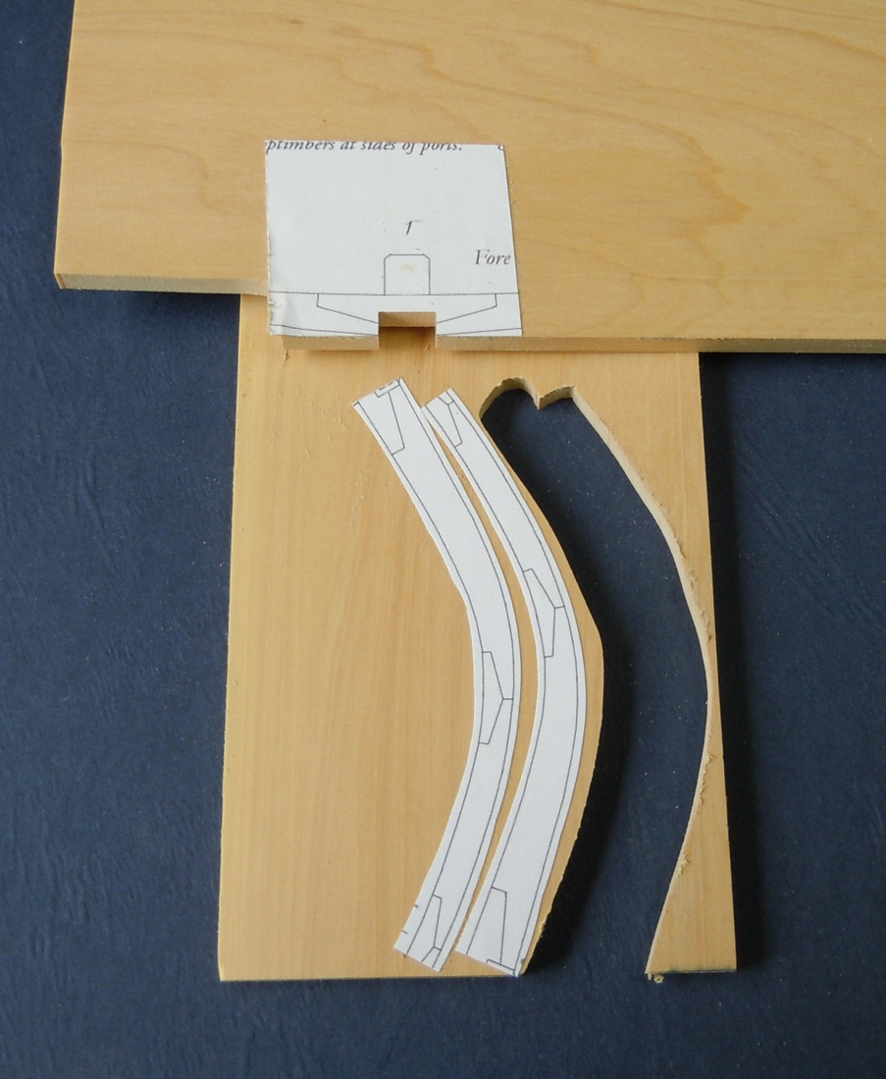
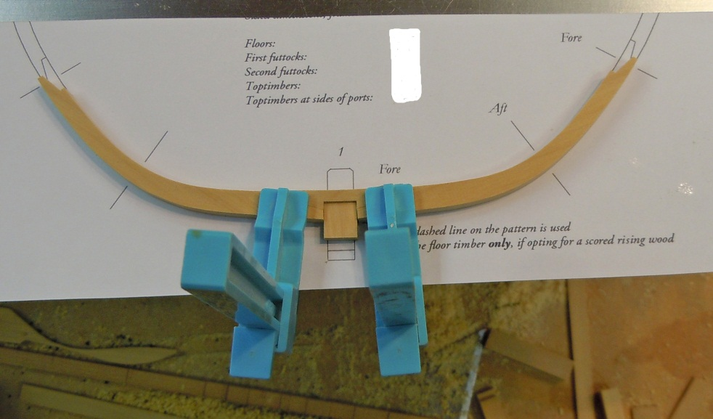
The Dead Flat Frame
The fore frames, starting with the dead flat, have a chock, second futtocks and toptimbers. The chock is made first, with the keel mortise cut on the table saw, and glued up over the frame pattern. A 15” keel template is glued to the plan to insure a tight fit of the assembly to the keel.

Slide 12
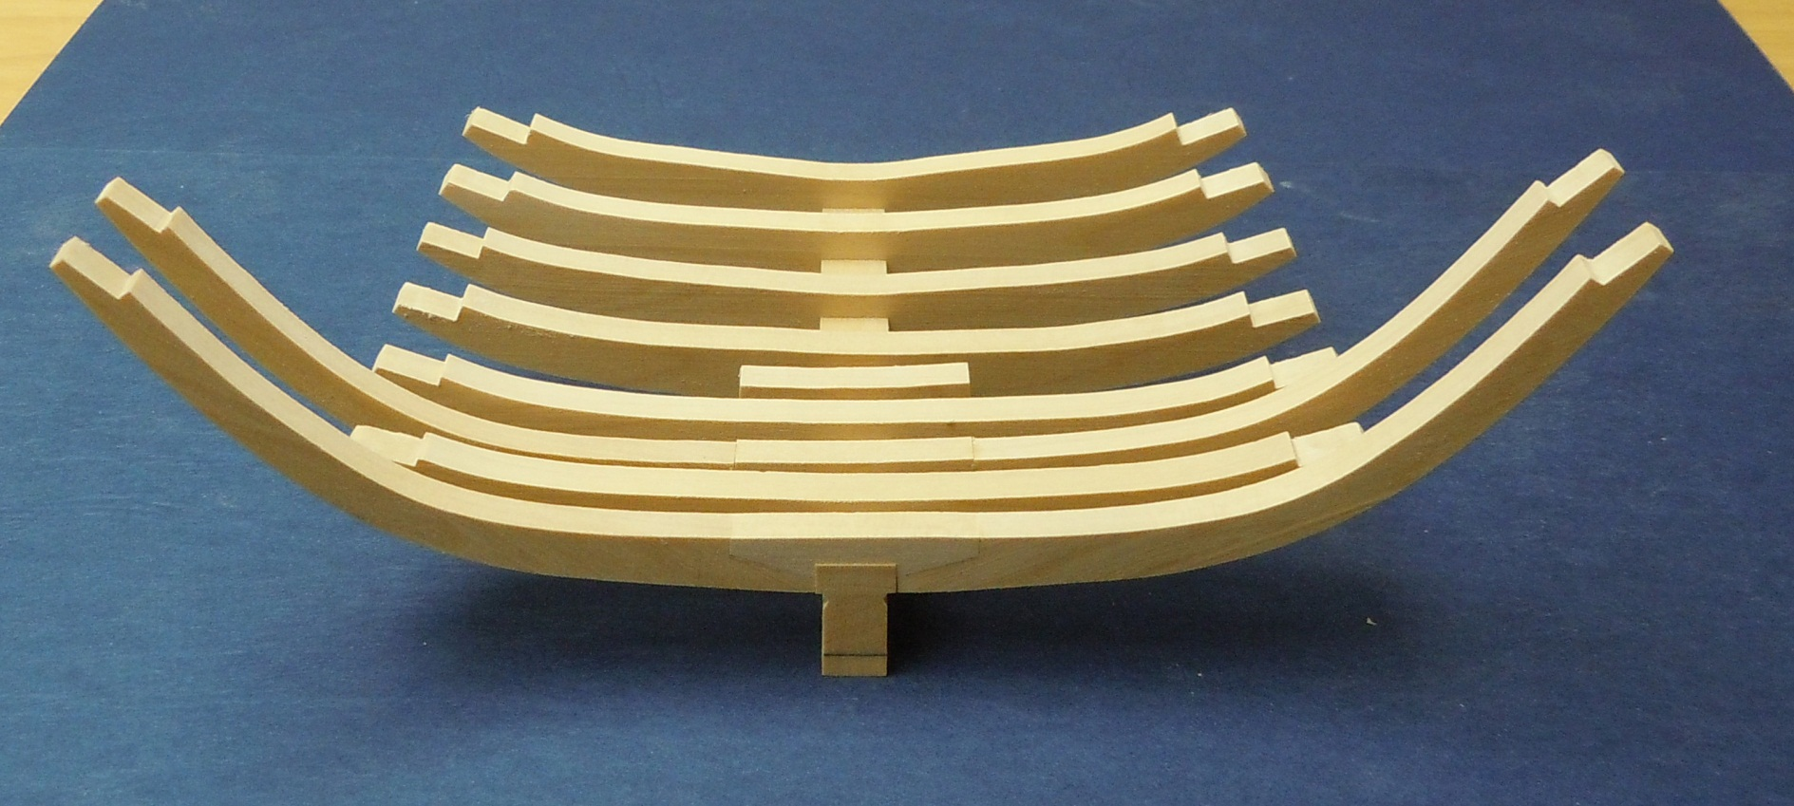
The First Futtocks
In similar fashion all the fore frames, with their chocks, are assembled and test fitted on the keel. No frames are glued in place for now.

Slide 13
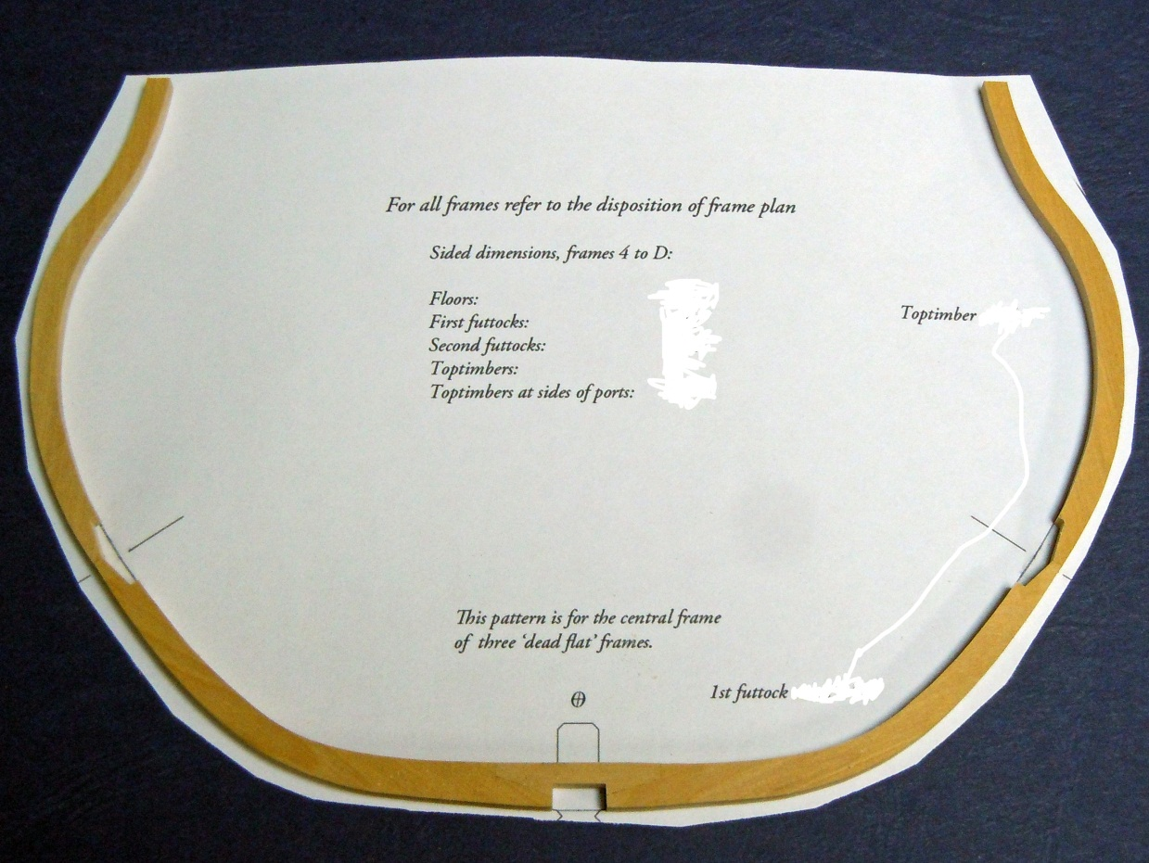
The Dead Flat Frame
The toptimber futtocks are cut and the ends glued to the second futtocks over the pattern. The toptimber is sided 1” less than the second futtock.

Slide 14
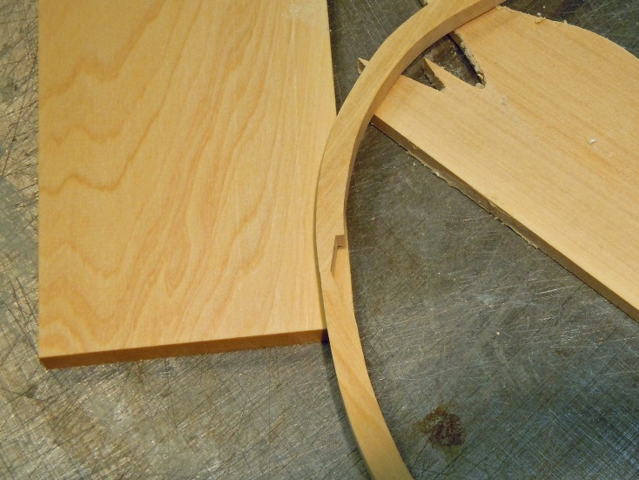
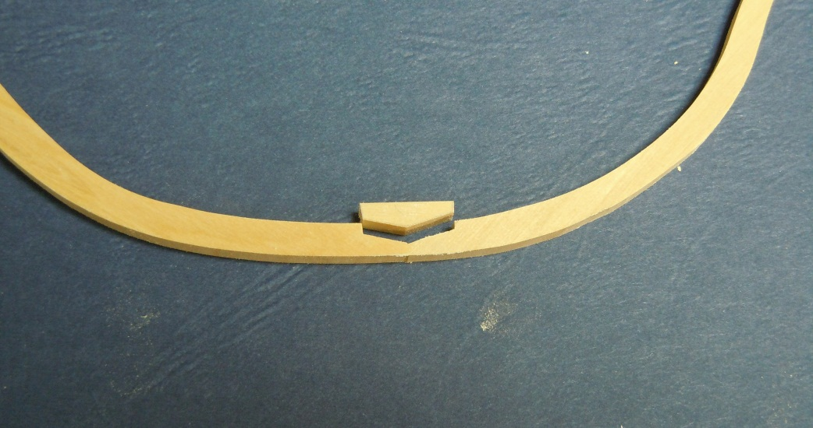
The Dead Flat Frame
The glued up frame is carefully placed over a wood blank of the same thickness and the chock shape traced. The chock is cut on the scrollsaw then fitted to the frame. Small refinements with a disk sander or sanding block will insure a tight fit. Be careful when handling the frames at this point as they are prone to break at the scarph joints. The chocks are glued in place with yellow carpenters glue and the frame is now very strong.

Slide 15
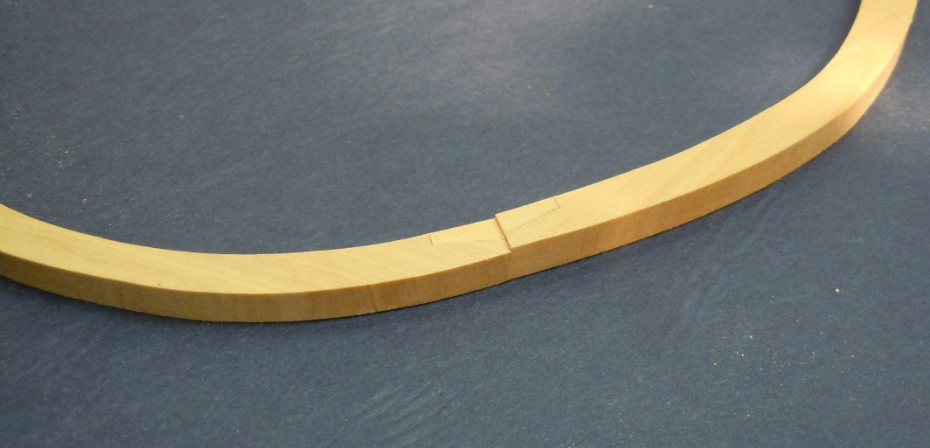
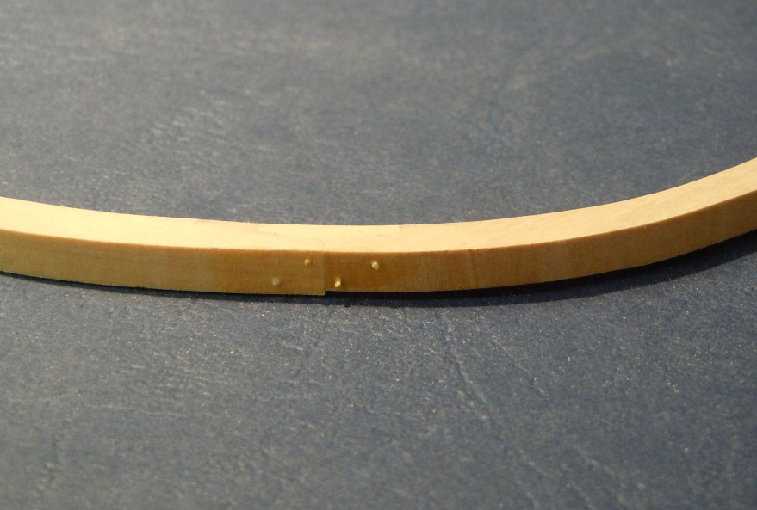
Finishing the Dead Flat Frame
The chock will sit 1”proud of the toptimber as it’s sided dimension is 1” less. A chisel is used to pare the chock flush with the toptimber. Treenails may be added at this point or later.
Treenails are made using the Byrnes treenail drawplate. For a ship this size they are drawn to the next to the smallest hole. A No. 76 (.018” drill bit drills the correct sized hole. Be sure to use the same pattern when drilling the holes.

Slide 16
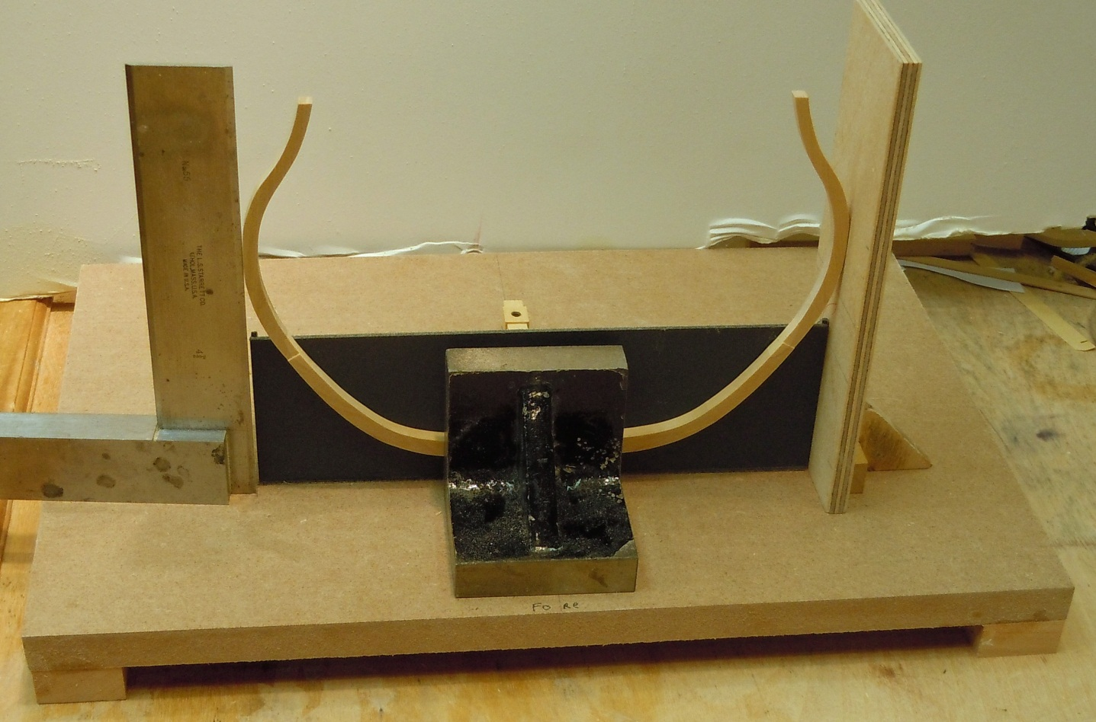
Raising the Dead Flat Frame
The dead flat frame is raised using the cardstock jig and machinist squares or 90 degree ply jig. What is important is that the frame is vertical and that the maximum height of breadth of the frame matches that drawn on the building board.

Slide 17
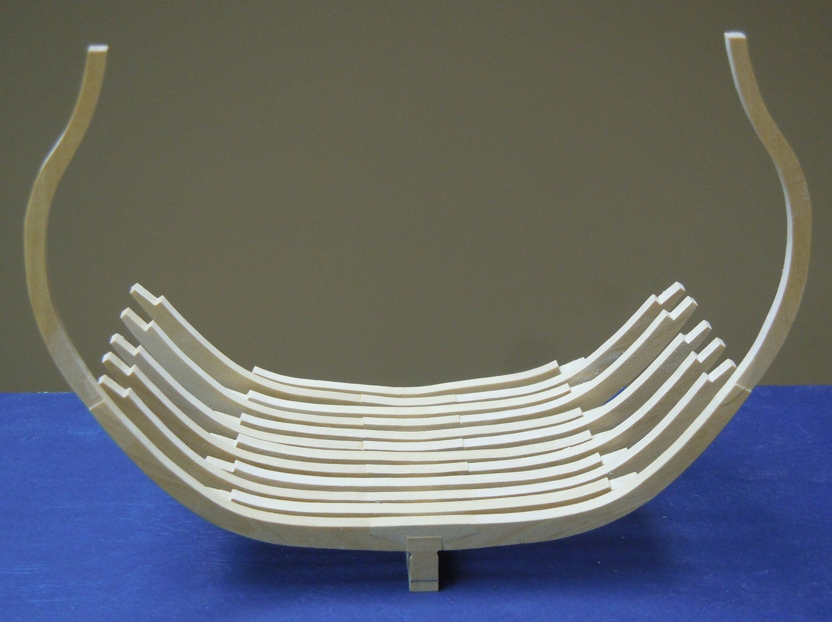
Raising the Dead Flat Frame

Slide 18
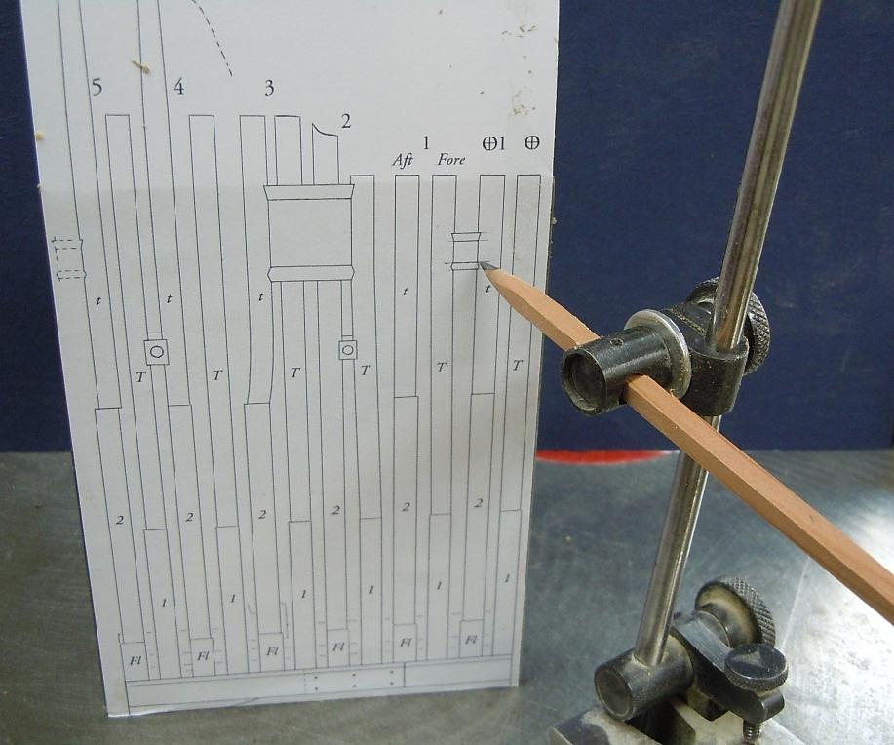
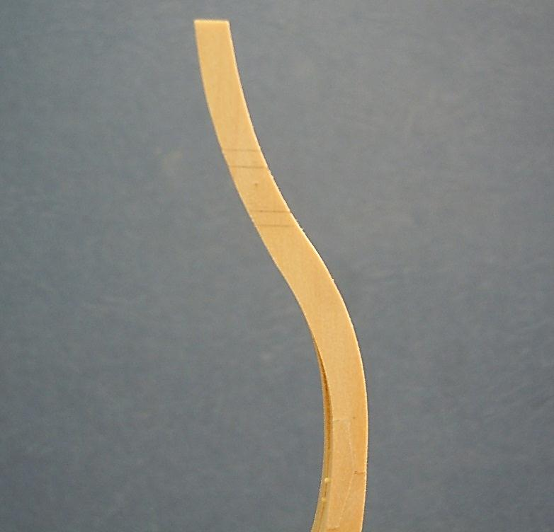
Frame Dead Flat 1
The dead flat 1 frame consists of a floor, second futtocks and toptimbers. The frame is constructed and chocked as before. The toptimber has mortises to receive the upper and lower port sills. Their height is taken on the sheer plan with a height gage and transferred to the temporarily tacked in place frame. The frame is then removed and the mortises cut with a chisel.

Slide 19
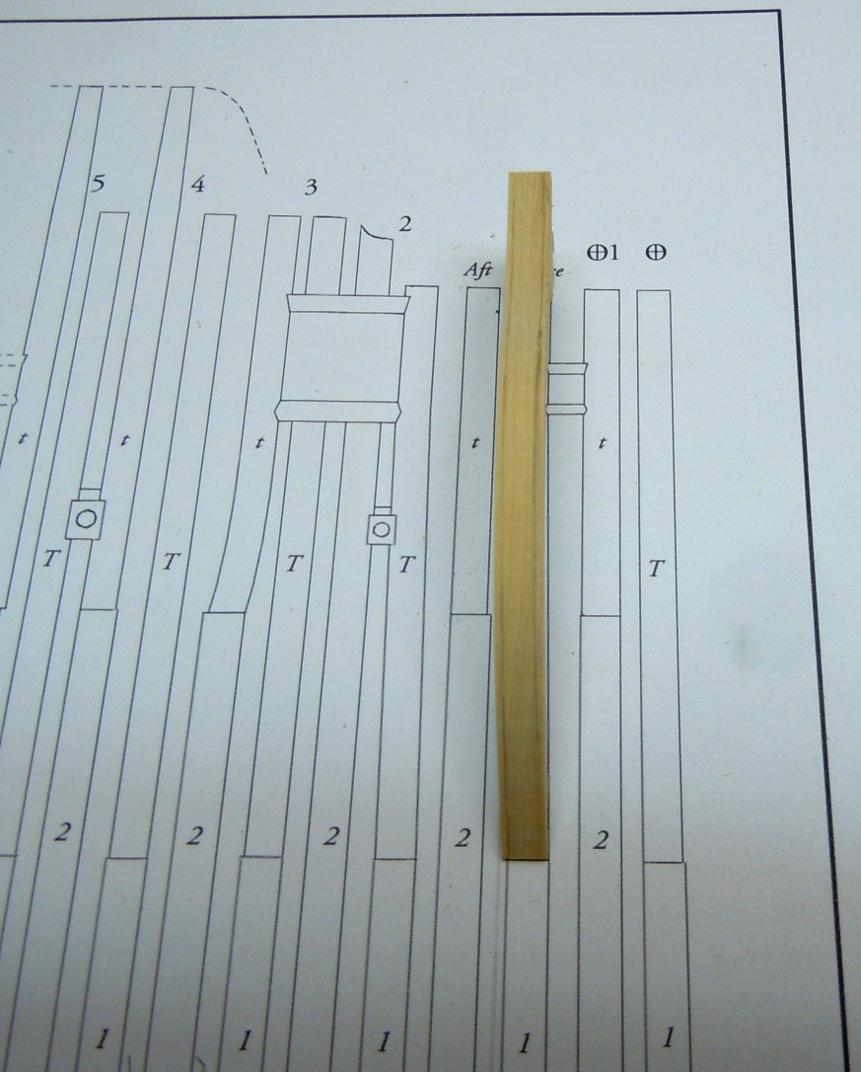
Frame 1 Fore
We have already prepared all the chock/first toptimber futtocks. The toptimber of frame 1 fore is shifted aft to accommodate the sweep port. The pattern is transferred form the sheer plan to the toptimber. The wood is removed with a chisel or spindle sander, being careful to preserve the sided dimension.

Slide 20
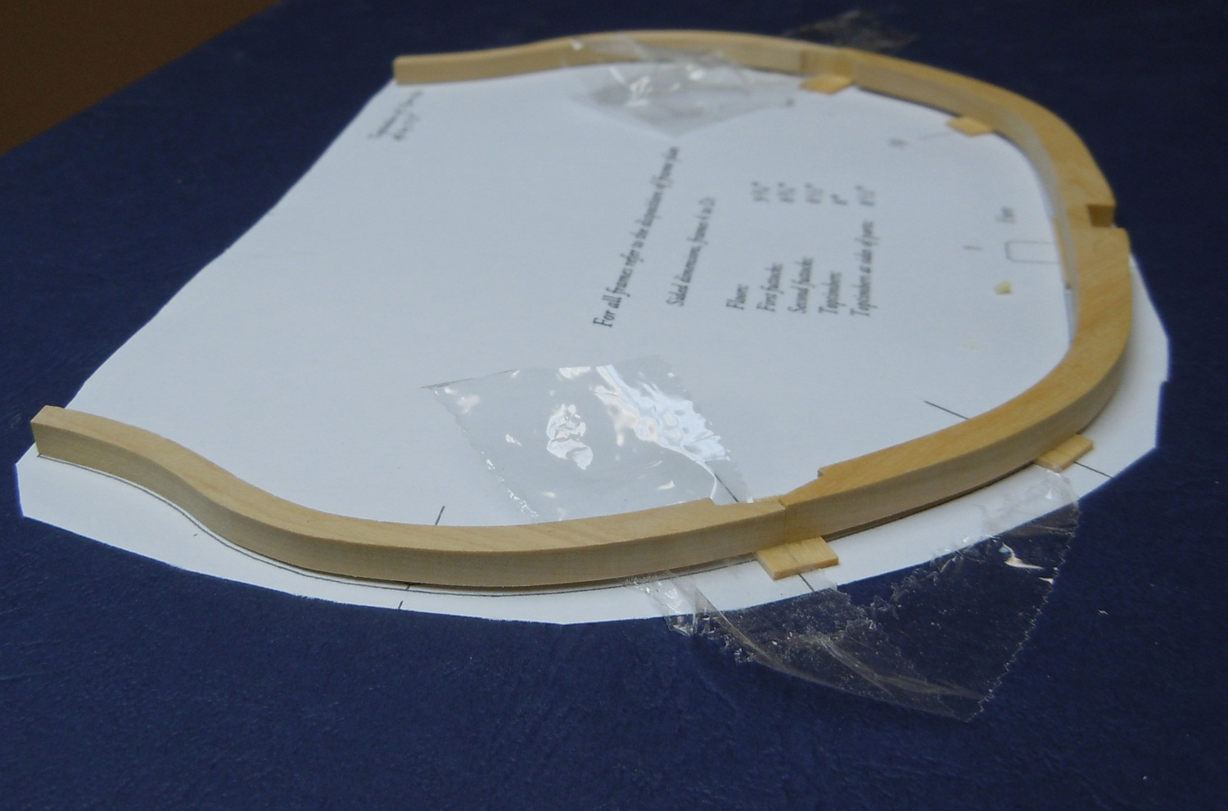
Frame 1 Fore
The shifted toptimbers are glued to the first futtocks. Spacers are used to maintain the proper 2 ½” shift when gluing. Chocks are added after the glue has set.

Slide 21
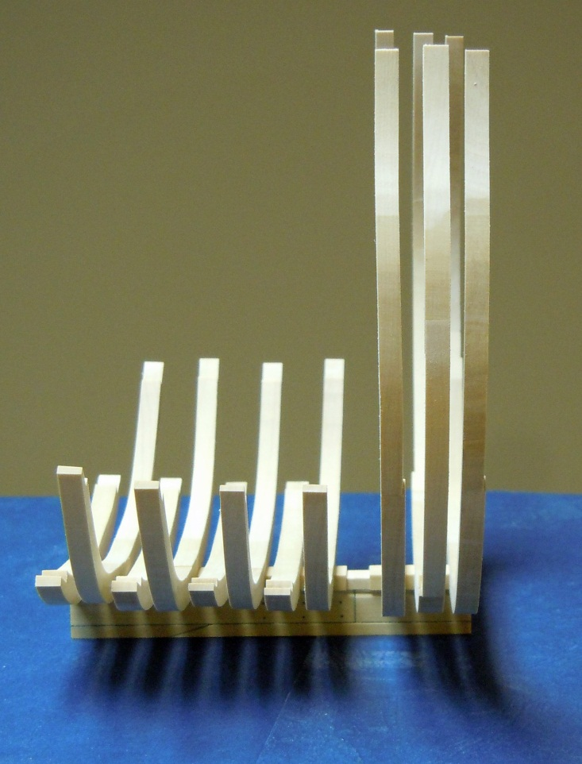
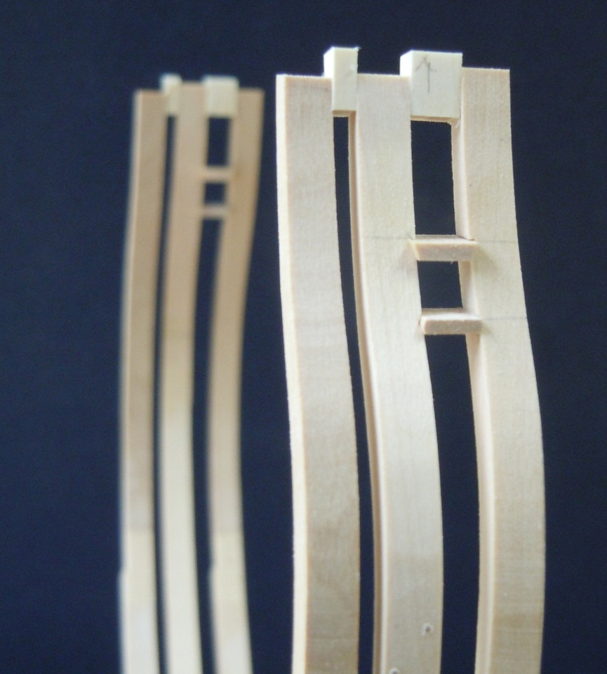
Frame 1 Fore
The sweep port sills are marked out as before, cut and the frame glued in place. The sills are added along with temporary spacers (right photo, starboard view).

Slide 22
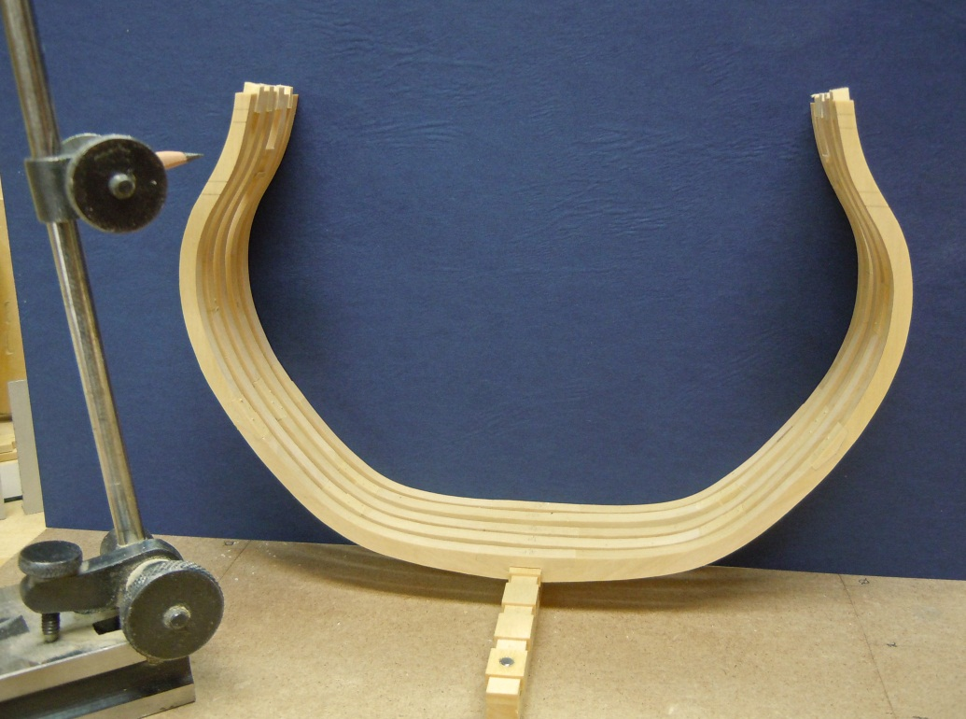
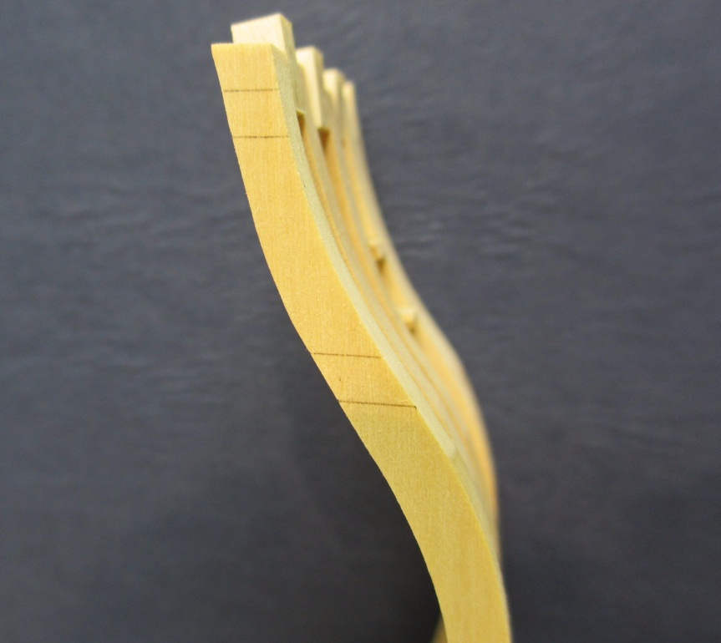
The Remaining Frames
The remaining frames are shaped and installed with care being given to the casts and shifts. Frame 2 fore shifts aft to form the fore face of the gun port. The markings for the sill mortises are being transferred above left. These markings are clearly viewed above right.

Slide 23
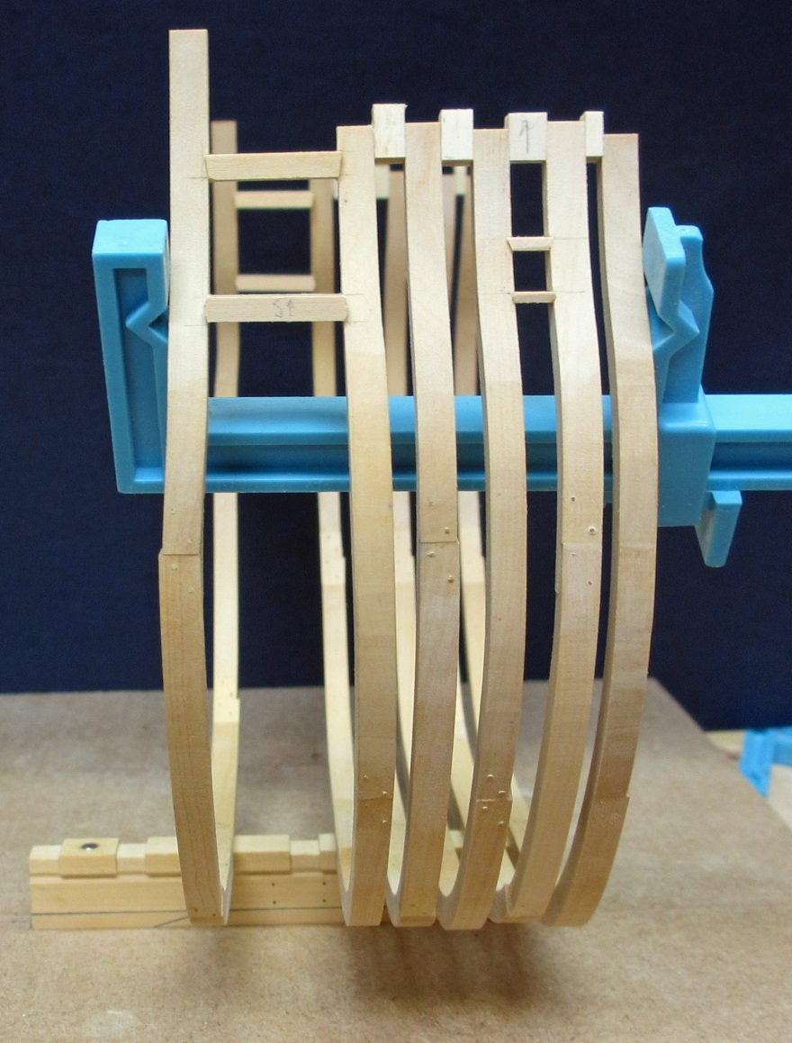
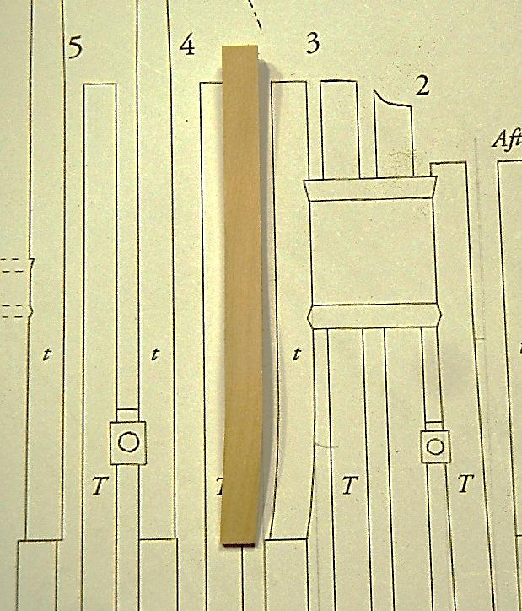
Frame 3 Fore
Frame 3 aft has a substantial shift forward to frame the aft side of the gunport. Note that it is cast 1” from the aft side of the second toptimber. The upper sills are beveled and the lower sills have a birdsmouth shape.

Slide 24
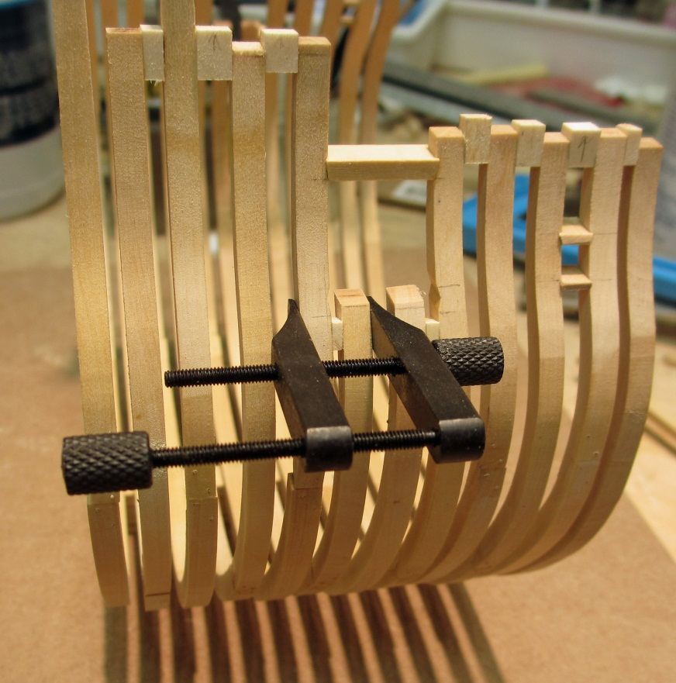
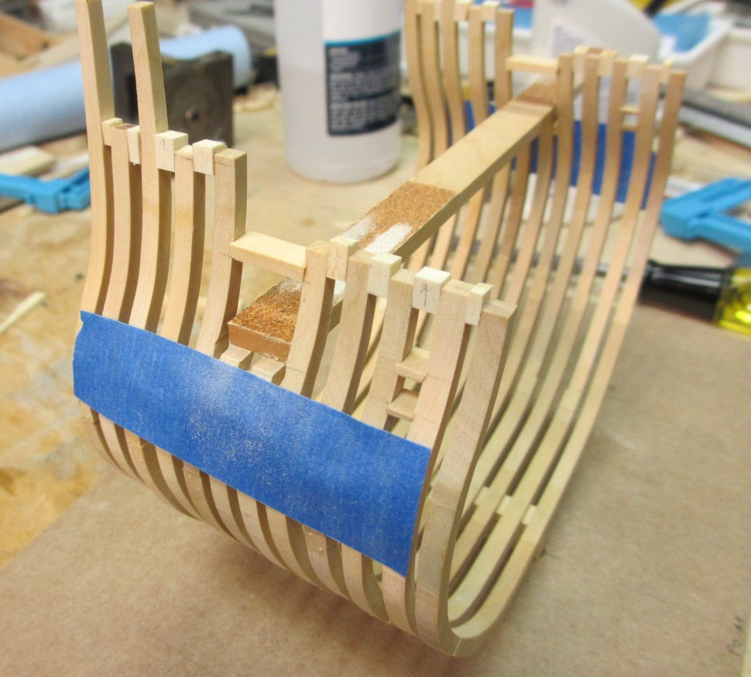
Framing the Gunports
With the upper sill installed frames 2 aft and 3 fore are glued in place with spacers to the adjacent frames. The lower sill height is transferred to the frames and a sanding stick is used to reduce them to their final height parallel orientation amidships.

Slide 25
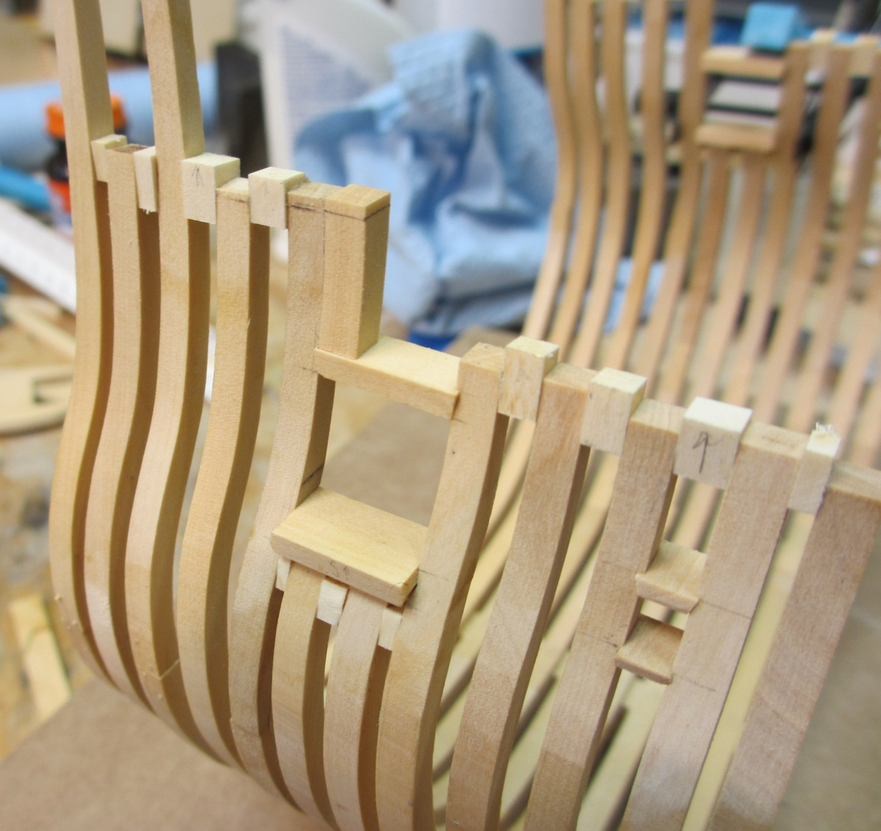
Sill and Toptimber Details
The lower sills are added and the toptimber above the sills is being constructed. It’s shape is derived from the toptimber of frame 3 fore. The toptimber of frame 2 aft is similarly made and the sided curve at the top is added before gluing in place.

Slide 26
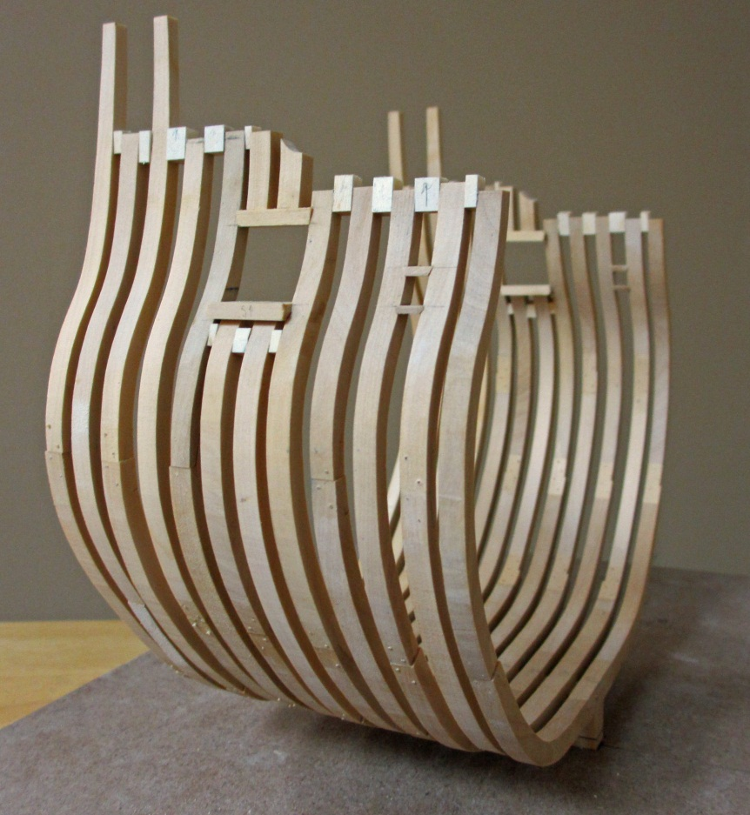
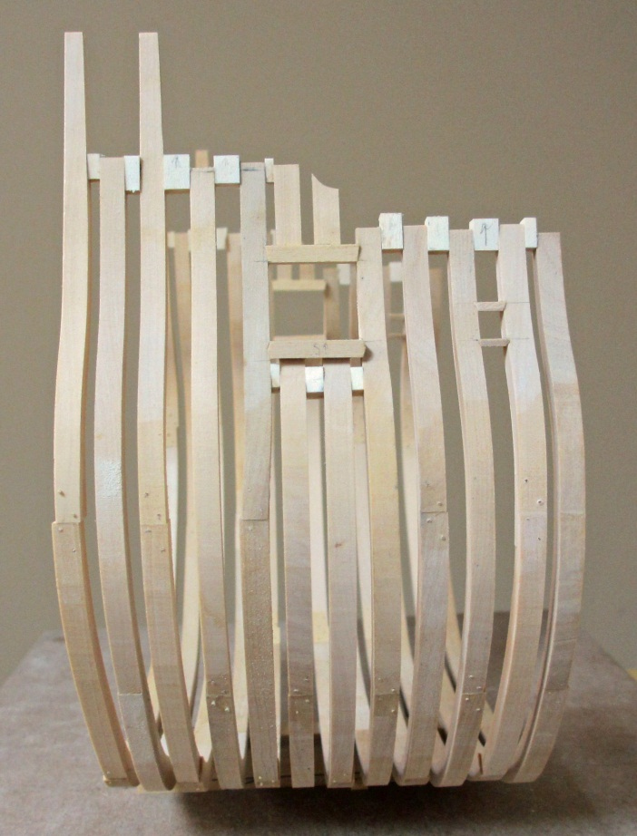
Completed Framing Prior to Fairing
Note the reduced shape of the toptimbers on frames 4 and 5 aft as well as the spacers between all the toptimbers to aid in fairing.

Slide 27
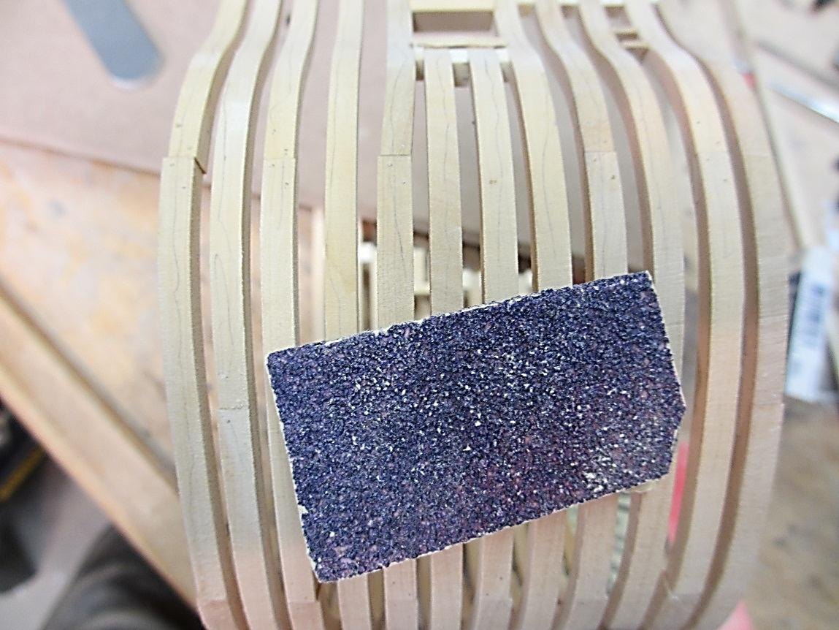
Fairing the Hull
Fairing the hull is easily done by placing pencil marks up and down all the frames. Starting with 80 garnet paper wood is removed until all the pencil marks are removed. Progressively finer garnet paper (120, 180 grit) is used as the fairing nears completion. Pencil marks are frequently reapplied to highlight low spots.

Slide 28
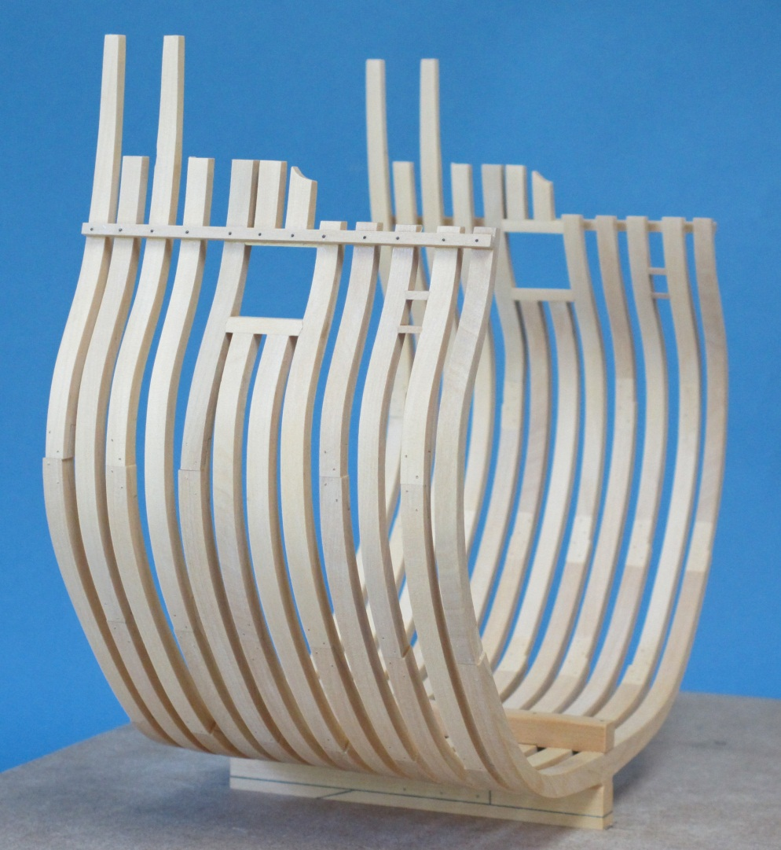
The Faired Hull - Exterior
Battens are installed at the toptimber line to prevent them from shifting.

Slide 29
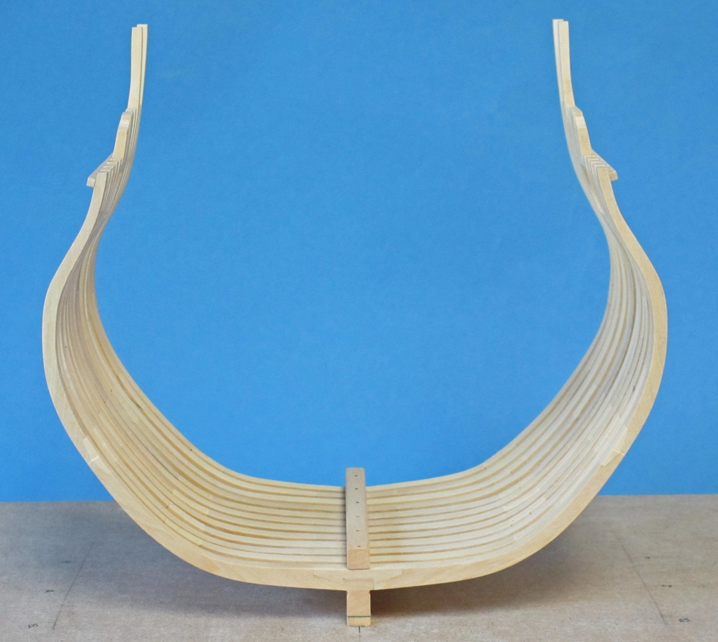
The Faired Hull - Interior

Slide 30
Fitting Out the Hull
Your fully framed hull may be displayed as is or fitted out to whatever extent you wish. As an example, the following cross-section model of the Swan class ship Pegasus is fully planked and fitted out with cannons, pumps and all planking. A photoetched sheet and cannons are available from Admiralty Models www.admiraltymodels.com to help in this regard.

Slide 31
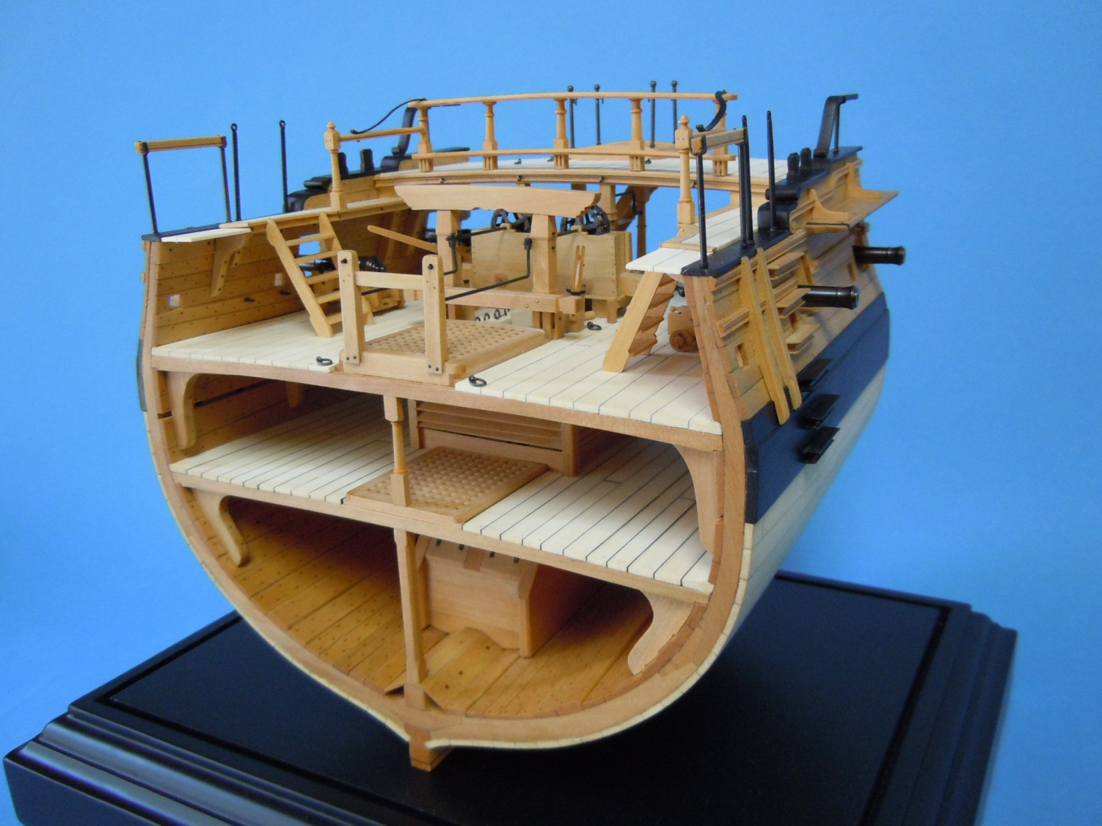

Slide 32
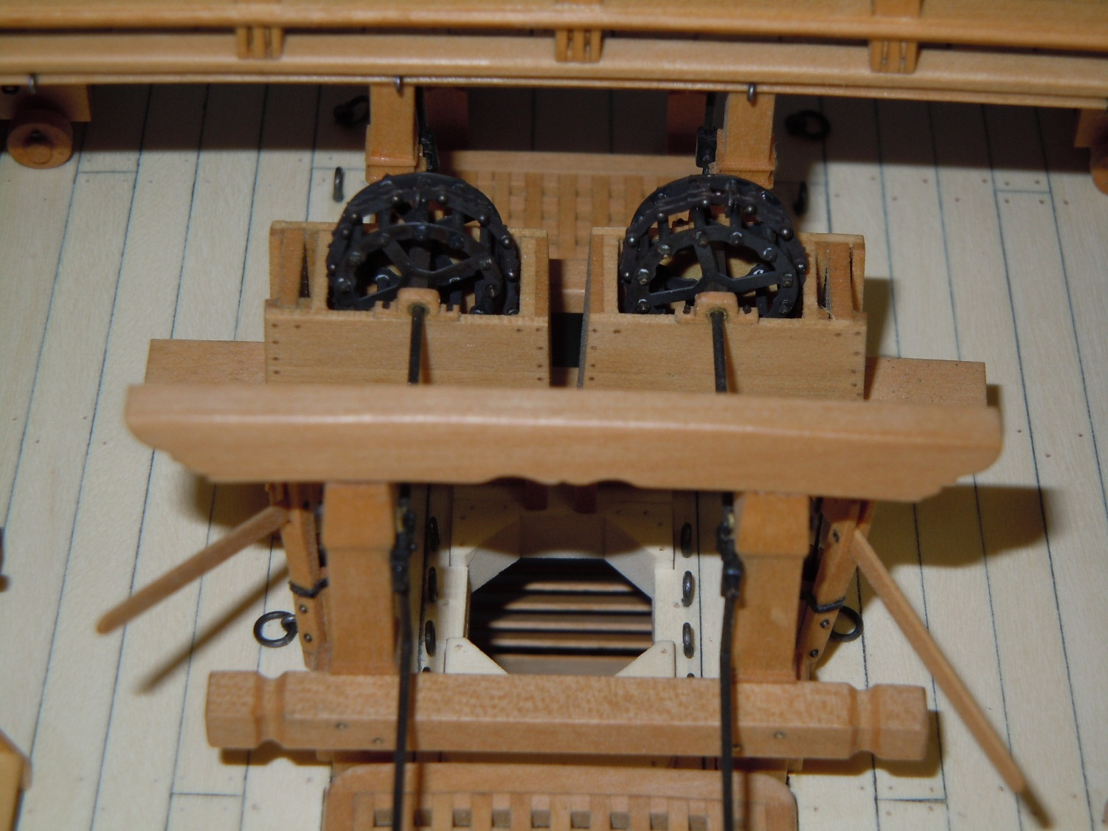

Slide 33
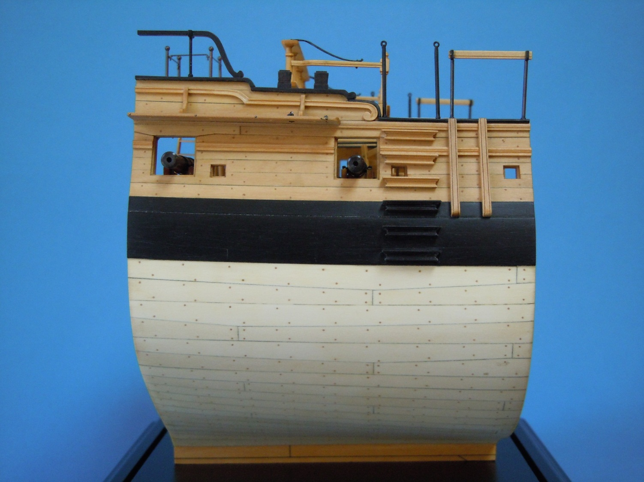

Slide 34
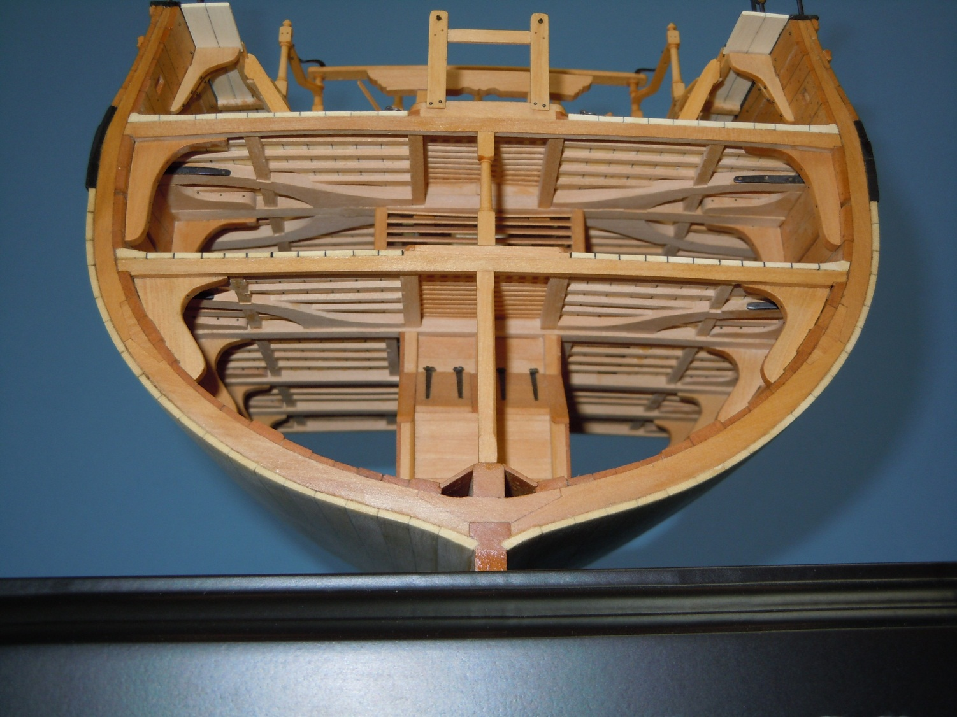

Slide 35
